Slide 1
Week4 Project
Kaiye Chen

Slide 2
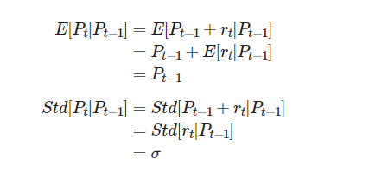
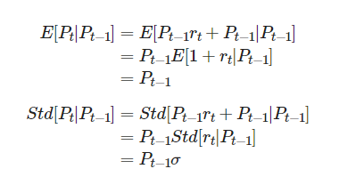
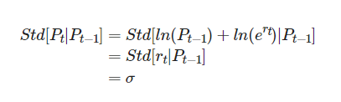
Problem1: Statistical Expectation
Classical Brownian Motion
Arithmetic
Geometric Brownian Motion

Slide 3
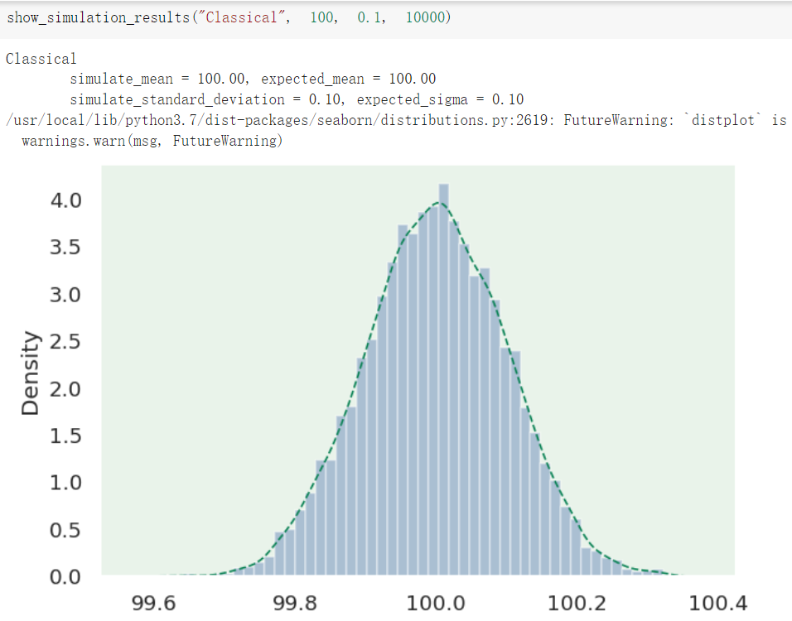
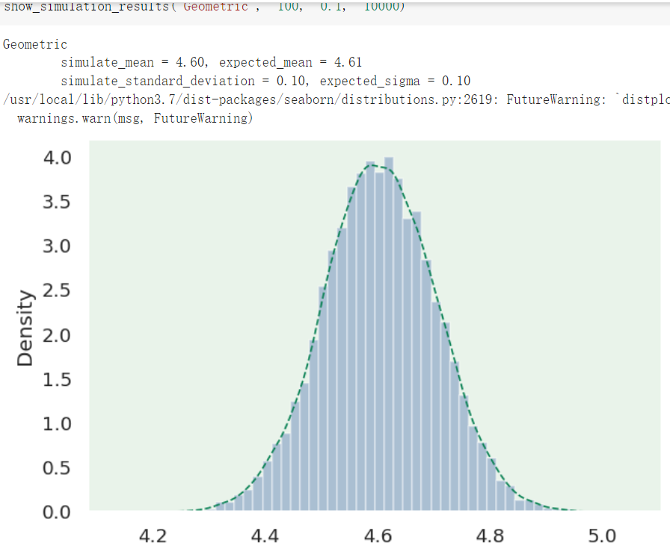
Problem1: Results

Slide 4
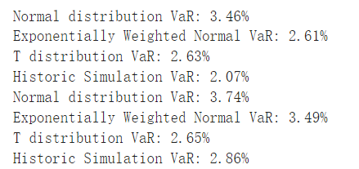
Problem2: VaR Comparison

Slide 5
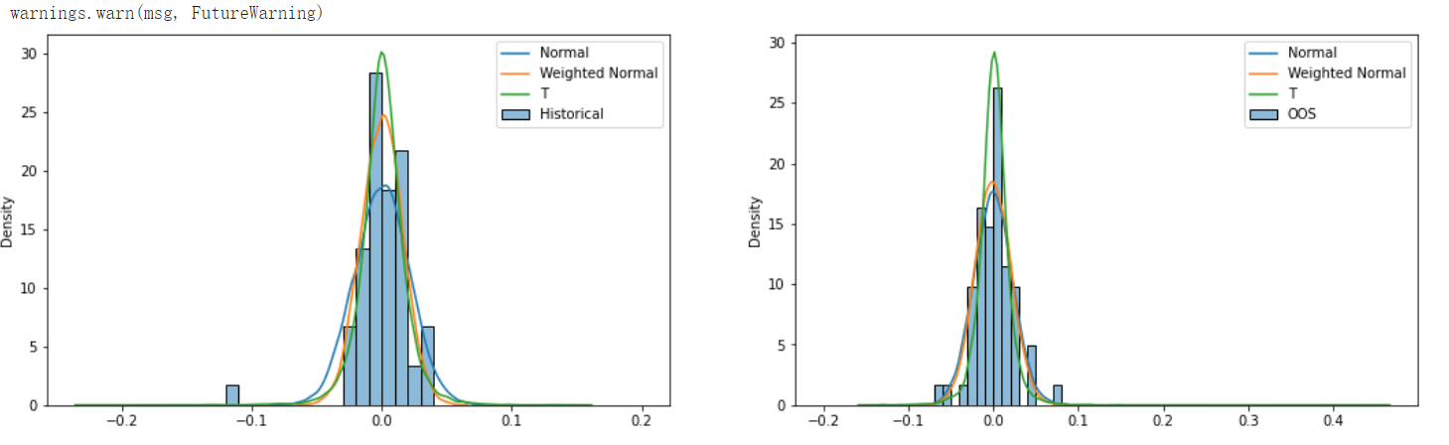
Problem2: Visualization

Slide 6
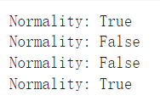
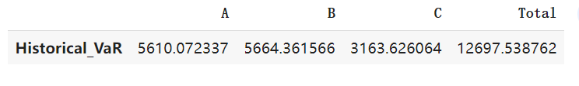
Problem3: Model chosen
Portfolio A,B,C,total are listed below:

Slide 7
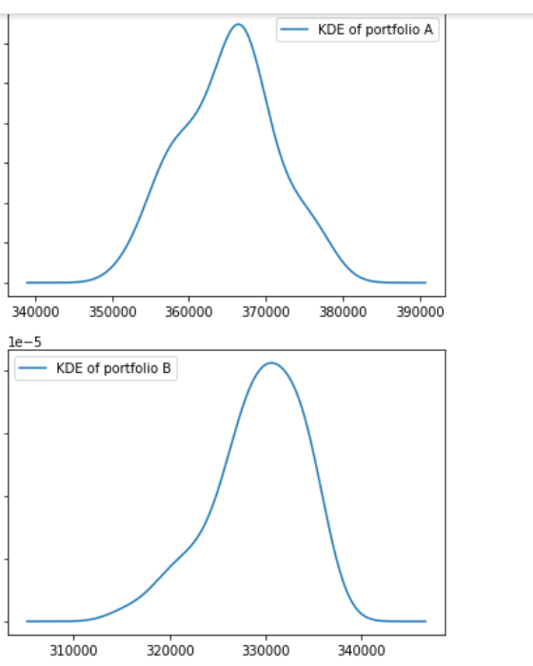
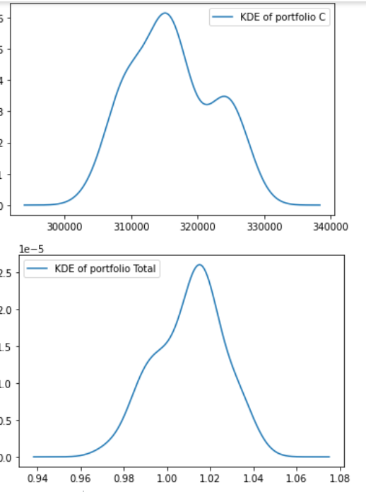
Problem3: Visualization

